Slide 1

This is about…
Believe
&
Strive
&
Achieve

Slide 2



The Pursuit of Happyness: Movie Presentation
Based on a true gripping and dramatic story about a man who has nothing and his struggle toward success .
By Team Lumos

Slide 3


Movie Presentation
1
Title
2
Team Name
The Pursuit of Happiness
Team Lumos
3
Team Members
4
Tagline
Mr. Aadil , Mr. Auli & Mr. Zarif
An inspiring drama about overcoming adversity and the pursuit of happiness.

Slide 4


Movie Details
Director
Gabriele Muccino
Release Date
December 15, 2006
Awards
Academy Award Nomination for Best Actor (Will Smith)
Golden Globe: Nominated for Best Actor (Will Smith)
Multiple Award Wins for Best Actor, Best Screenplay & Making Biographical film.
Will Smith (Chris Gardner), Jaden Smith (Christopher Jr.), Thandie Newton (Linda Gardner)
Main Cast

Slide 5




Main Characters
Chris Gardner
Christopher Jr.
Linda Gardner
Struggling salesman , Hard worker, determined father, driven by love for his son.
Young son of Chris, Symbol of hope, support and resilience.
Chris's estranged wife, Practical and realistic, Adds emotional complexity to the story.

Slide 6

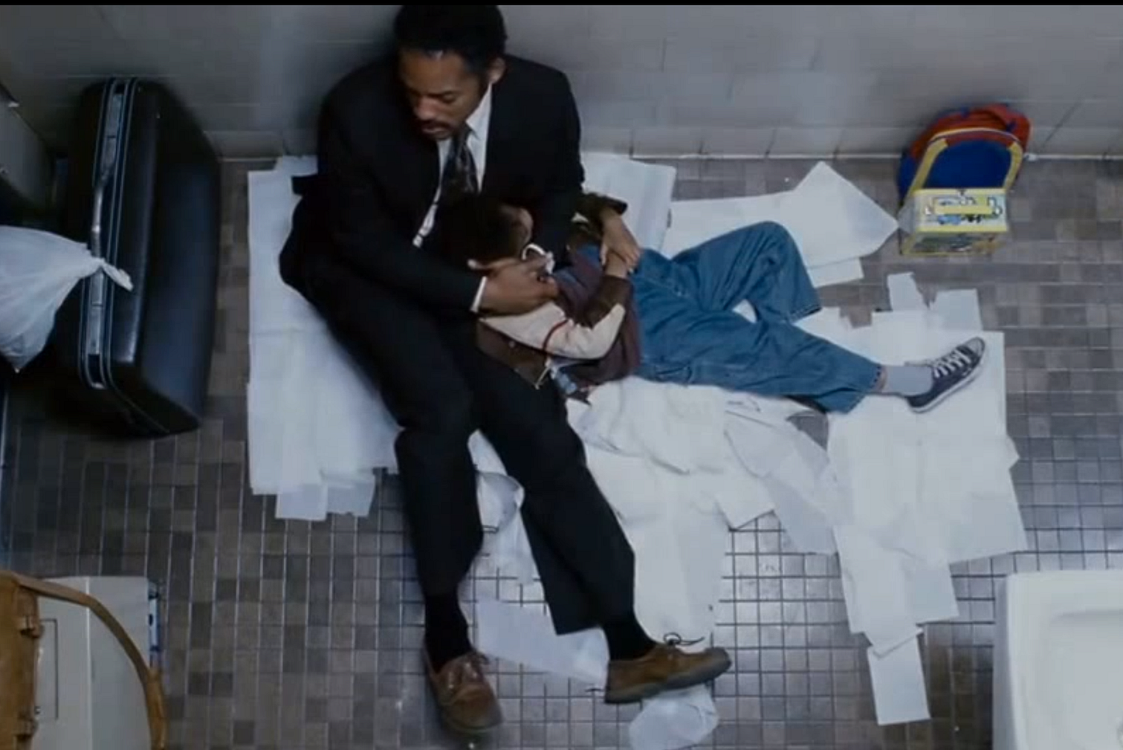

StoryPart 1
1
Financial Struggle
Chris makes a bad investment in medical devices.
Chris and his son become homeless and are evicted.
2
Personal Challenges
Chris faces separation from his wife.
Struggles with health issues.
3
Opportunity
Hopes hard work leads to a full-time job.
Aims to provide for his son.

Slide 7
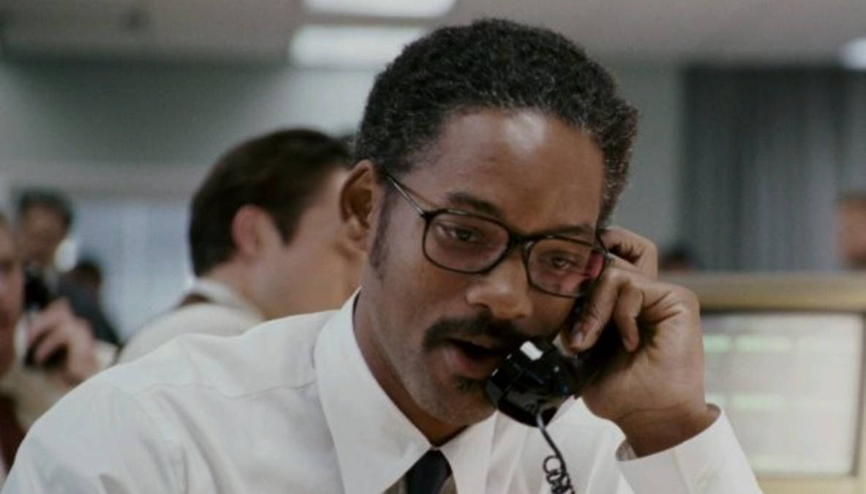

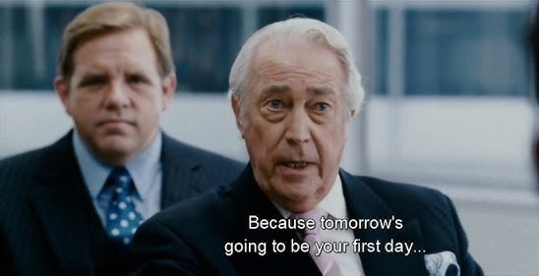

Story Part 2
Juggling Responsibilities
Chris juggles internship and caring for his son.
Perseverance
Receives a full-time job offer at the firm.

Slide 8
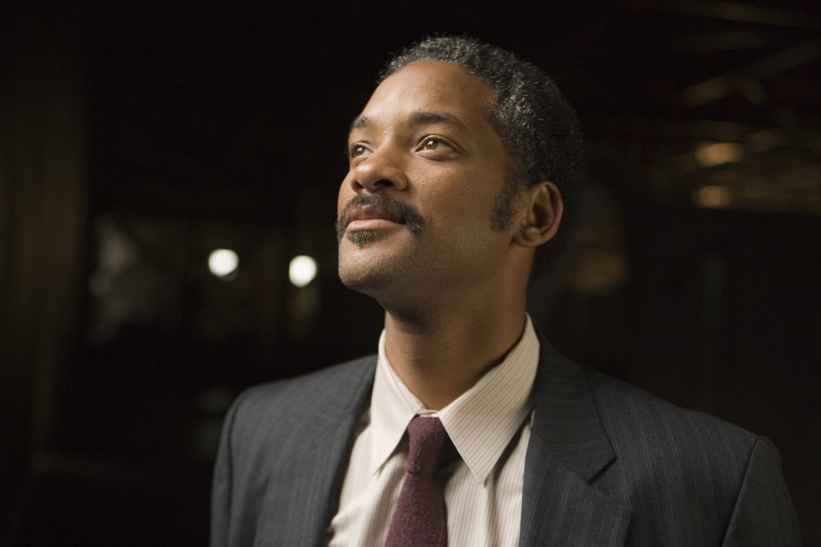
Life Lessons
Never Give Up
The Power of Hope
Never give up, even when the odds are against you.
Hope drives action even in dark times.
Parenthood & Sacrifice
Self-Belief
A parent's love can create pathways to success.
Believing in yourself is key to overcoming obstacles.

Slide 9

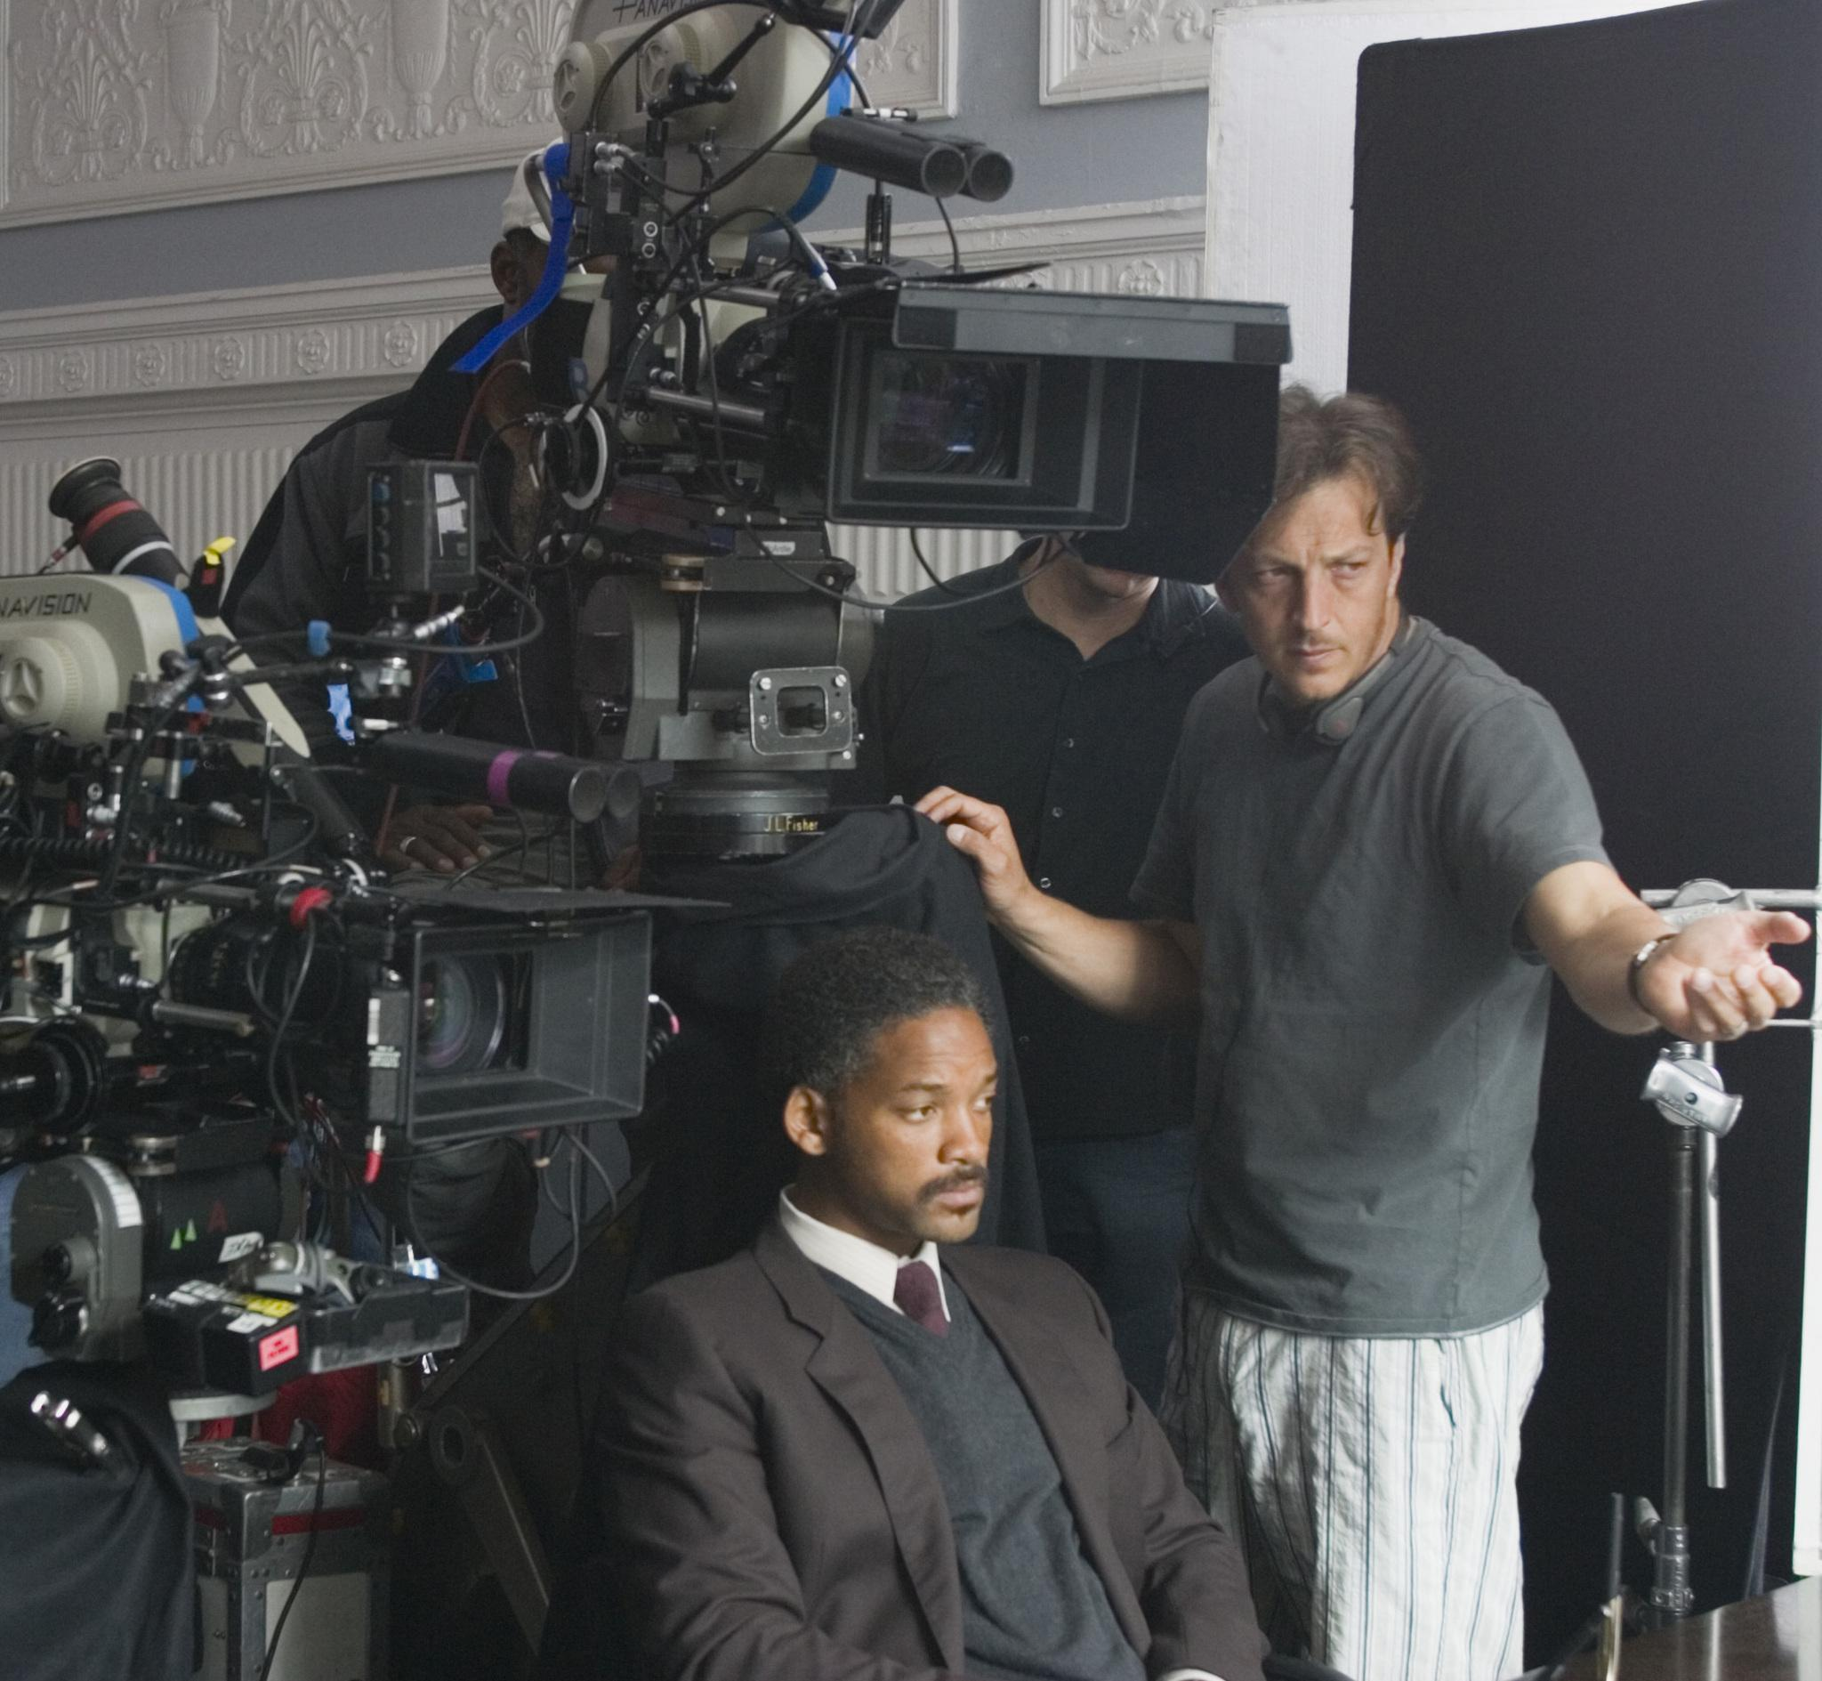



Room for Improvement
Pacing
Some sections could be tighter for better flow.
Supporting Characters
More development of secondary characters could add depth.
Realism
The movie could explore the harsh realities of homelessness more deeply.

Slide 10

Concluding Thoughts
1
Inspiring Tale
2
Important Themes
3
Success Redefined
The Pursuit of Happyness_ is an inspiring tale of perseverance and resilience.
Demonstrates the importance of love, hope, and determination.
A reminder that success is not just financial, but emotional and personal.

Slide 11

Question & Answer
We’d love to hear your thoughts and questions !

Slide 12


